Slide 1
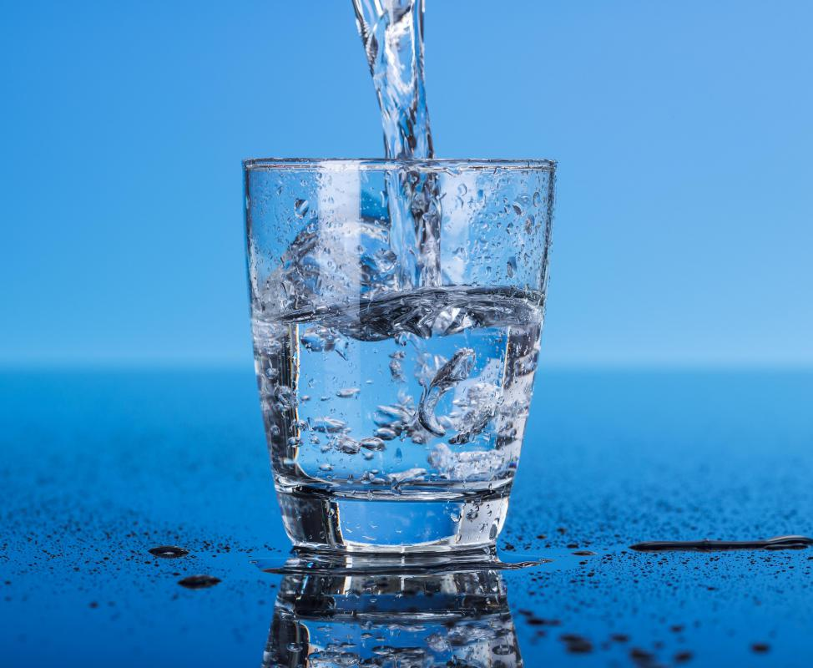
Drinking water potability prediction Group n0.08 Navdeep kaur Navneet kaur Harmanpreet kaur sumal Manpreet kaur

Slide 2
Content
Introduction
Problem Statement
Objective
Dataset Description
Analysis
Results
Conclusion

Slide 3
Introduction
Water is one of the largest resources on earth. People need water to sustain life, including drinking water. It is important to know whether drinking water - human life resource - is enough for everyone now and in the future. However, water resources are not evenly distributed everywhere on the planet.
While the water resource is rich in some countries and regions, it is not enough for some other regions. In this project, we analyze the potability of water by using an Indian water potability dataset.
According to the World Health Organization, 97 million Indians, second only to Chinese people, do not have access to adequate healthcare.

Slide 4
Problem statement
The public requires access to safe, easily accessible water for drinking, household usage, food production, and recreational activities.
A country’s economic development may be considerably boosted by better water supply and resource management.
Due to contaminated water every year, lots of people experience kidney failure, cancer, etc. Contaminated water can lead to diarrhea, cholera, typhoid, etc.
In the wake of rapid urbanization and industrialization, the consequences of polluted water are far-reaching, affecting every area of human existence.

Slide 5
Why this problem is important to solve

Slide 6
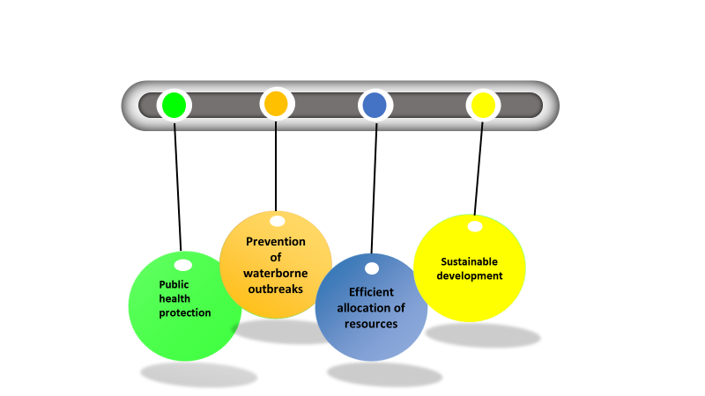

Slide 7
Why Water is not Safe to Drink
Improper Agricultural Practices
Reduction In Water Quantity
Oil leaks from ships
Acid Rain
Industrial waste

Slide 8
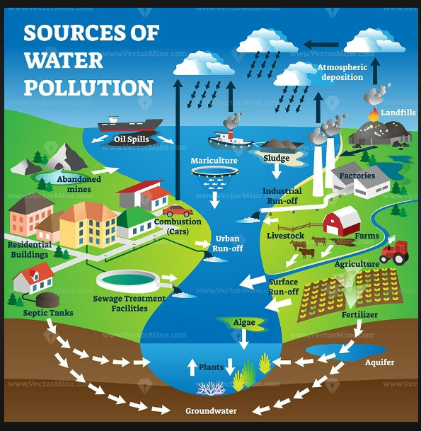

Slide 9
Objective
The main objective of the project is predicting the quality of water. By Using the Machine learning techniques with a Random forest, Logistic Regression, KNN and XGB algorithms we predict the water quality that is Excellent, Good, Poor, Very Poor and Non-Drinkable. By calculating the parameters like PH, Temperature, Conductivity, Total Coliform, Dissolved Oxygen, Nitratenne and Biological demand for oxygen.

Slide 10
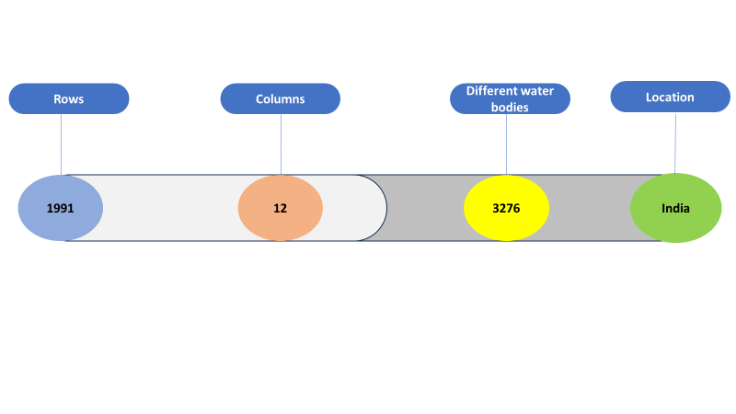
Dataset Description

Slide 11
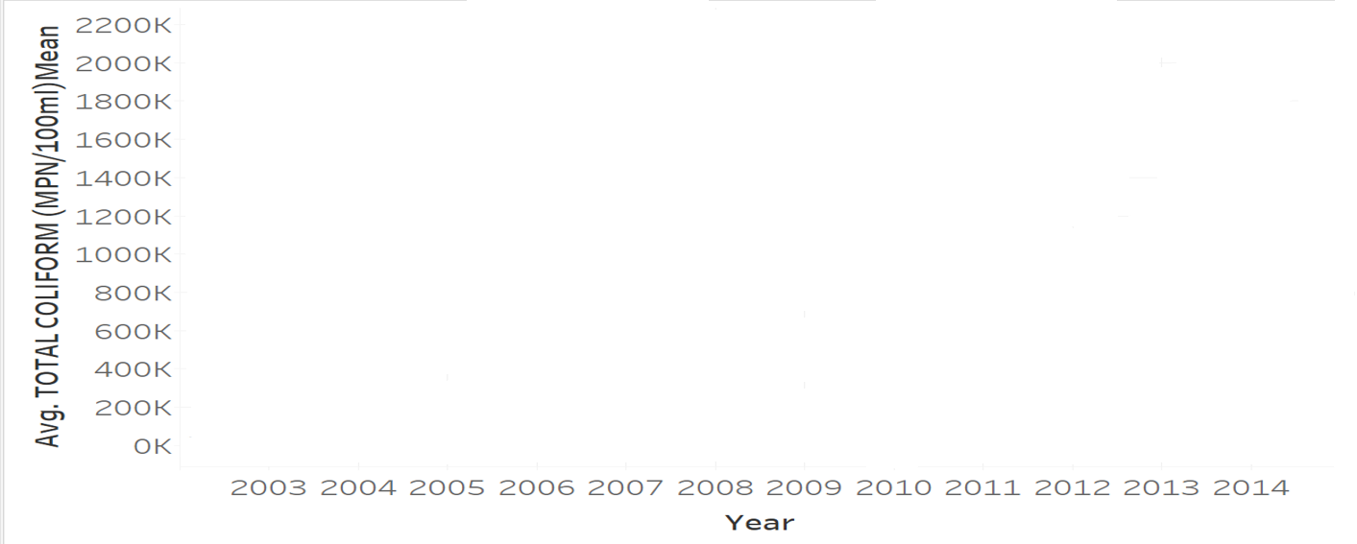
Average value of total coliform over time

Slide 12
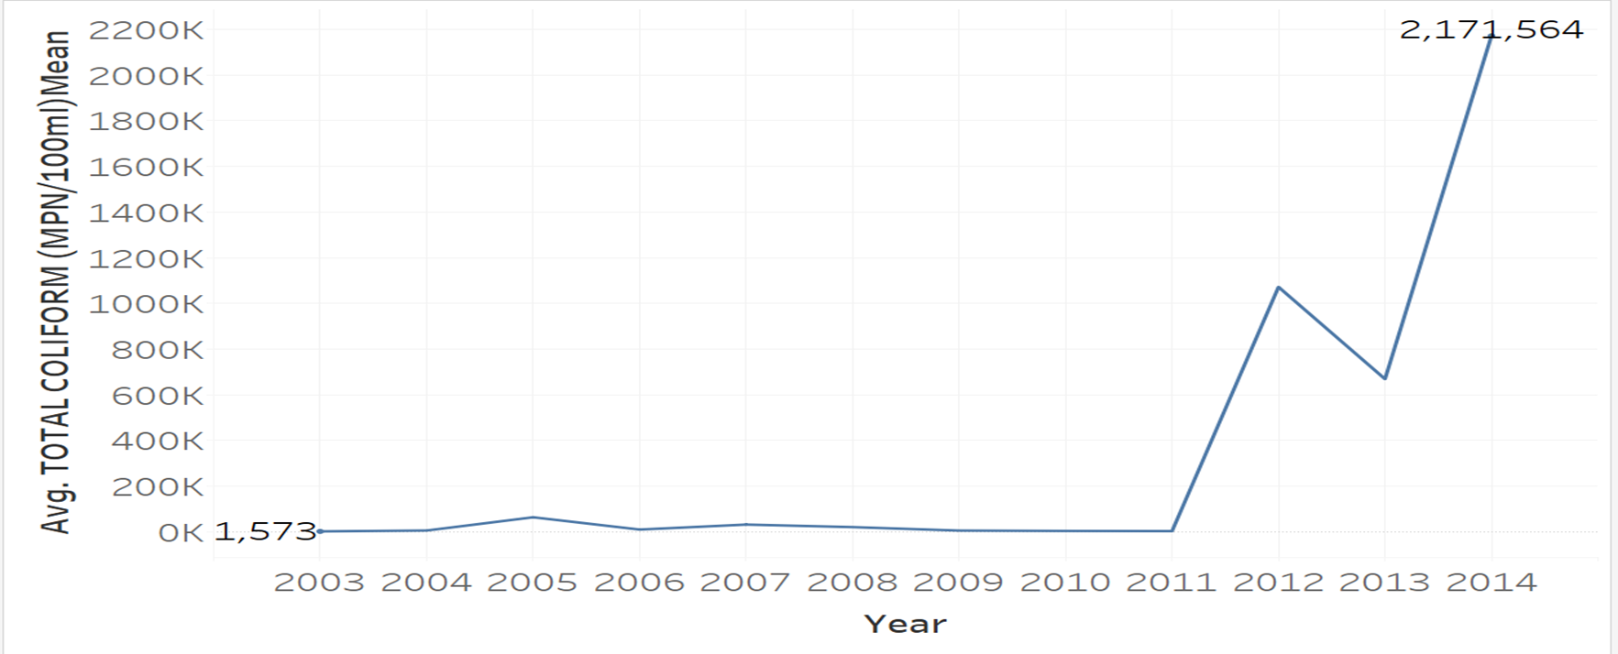

Slide 13
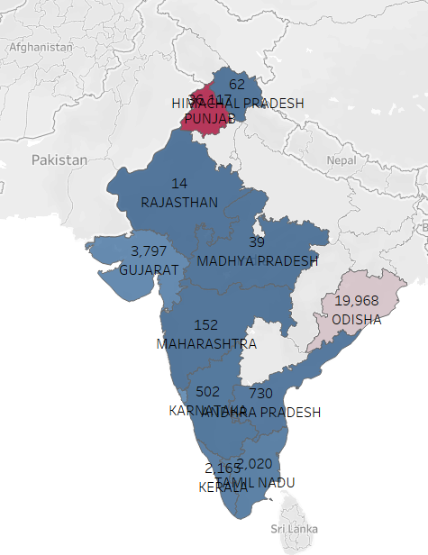
Average value of Total coliform according to states

Slide 14
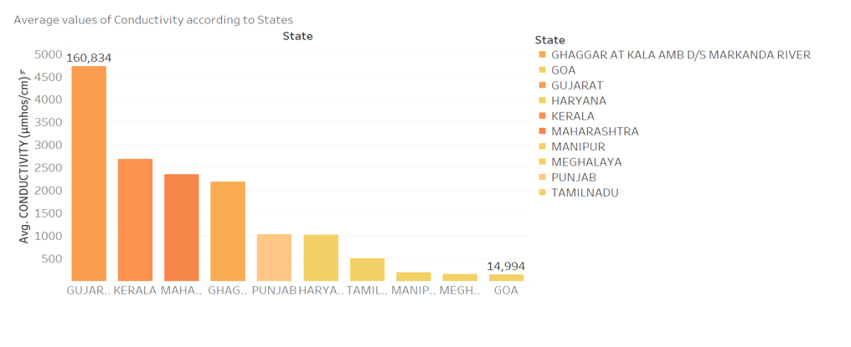
Average value of Conductivity of Top10 States

Slide 15
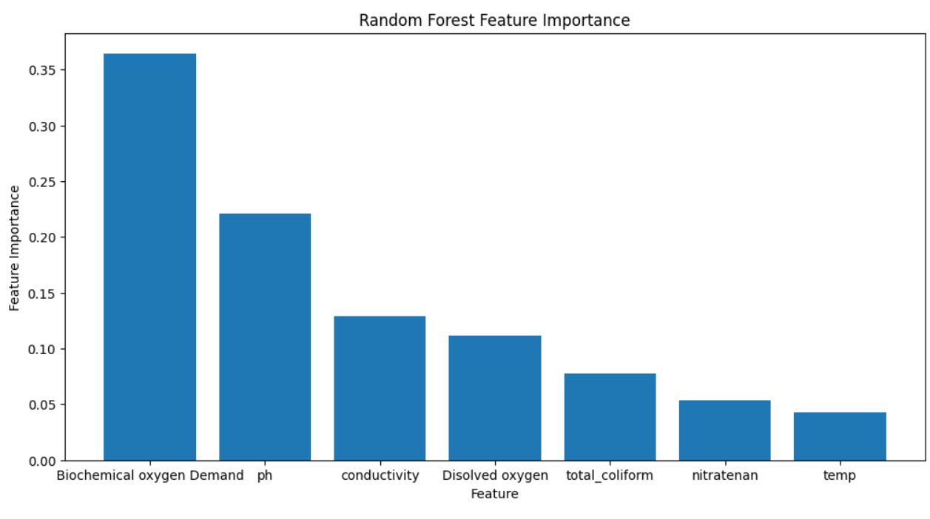
Feature Importance

Slide 16
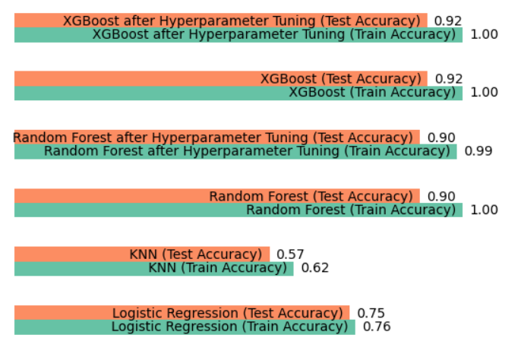
COMPARING THE RESULT OF ALL MODELS

Slide 17
CONCLUSION
To conclude, after applying Random forest, XGboost, KNN and logistic regression on selected dataset to predict the quality of water. We get the highest accuracy with random forest and XGboost but the logistic regression models would be best to predict the quality of water because the other models overfit.

Slide 18
Future Scope
Our model will assist in lowering the amount of poor-quality water that people consume, hence reducing the spread of terrible illnesses like typhoid and diarrhoea.
This method allows for focused actions for environmental and public health management, which holds potential for more effective water quality monitoring, particularly in areas with limited resources.
The suggested machine learning models aids the preservation of water resources and the general health of ecosystems by improving monitoring efforts and promoting sustainable water management practices.

Slide 19

Thank you

